Slide 1
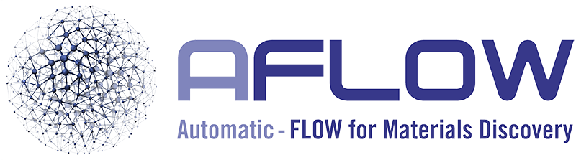

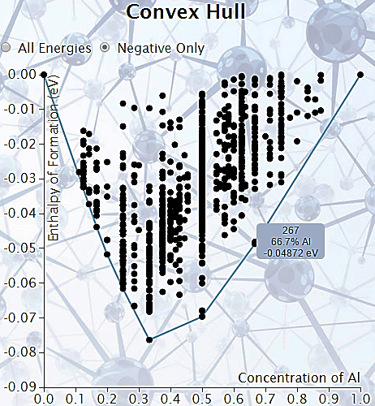
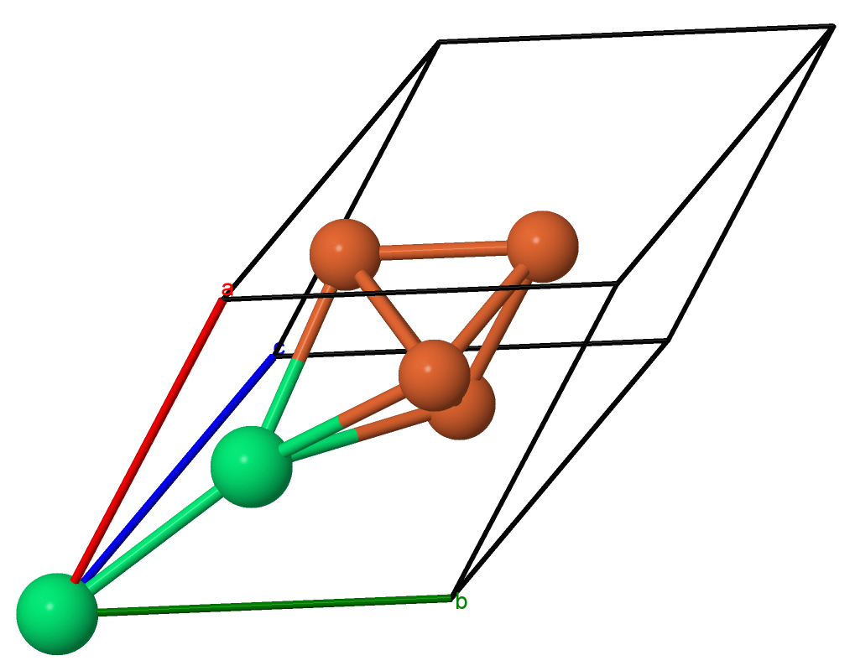
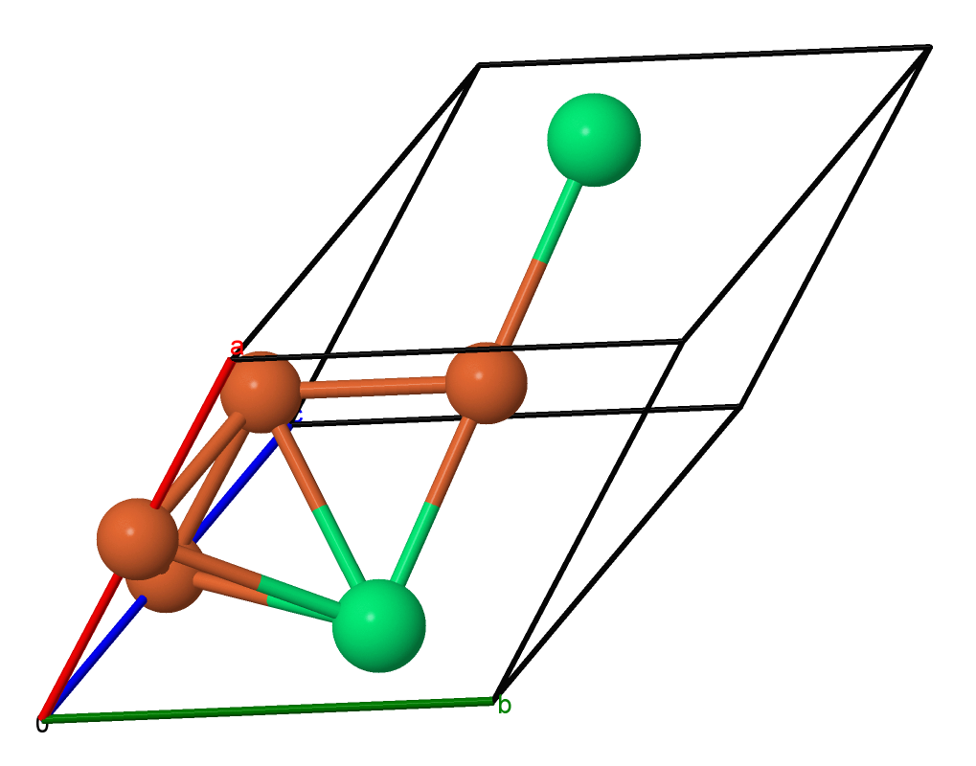
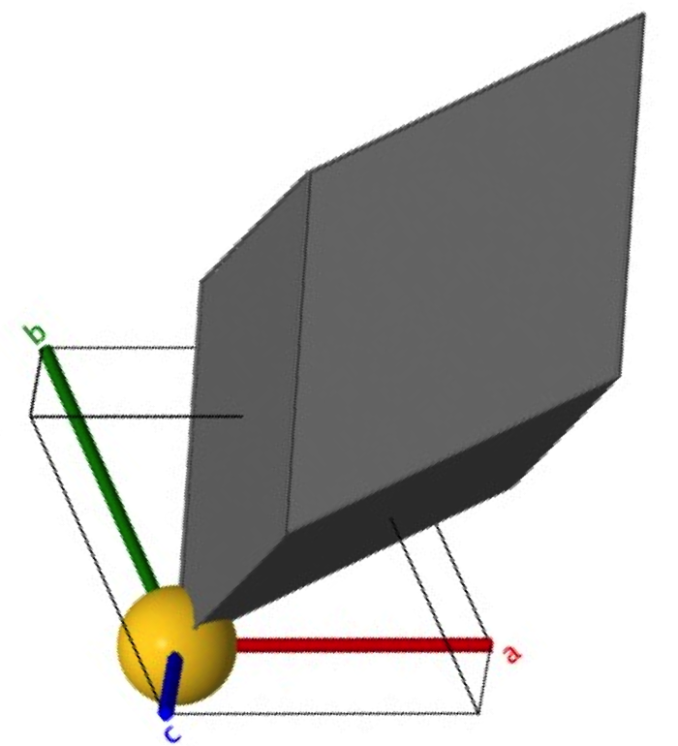
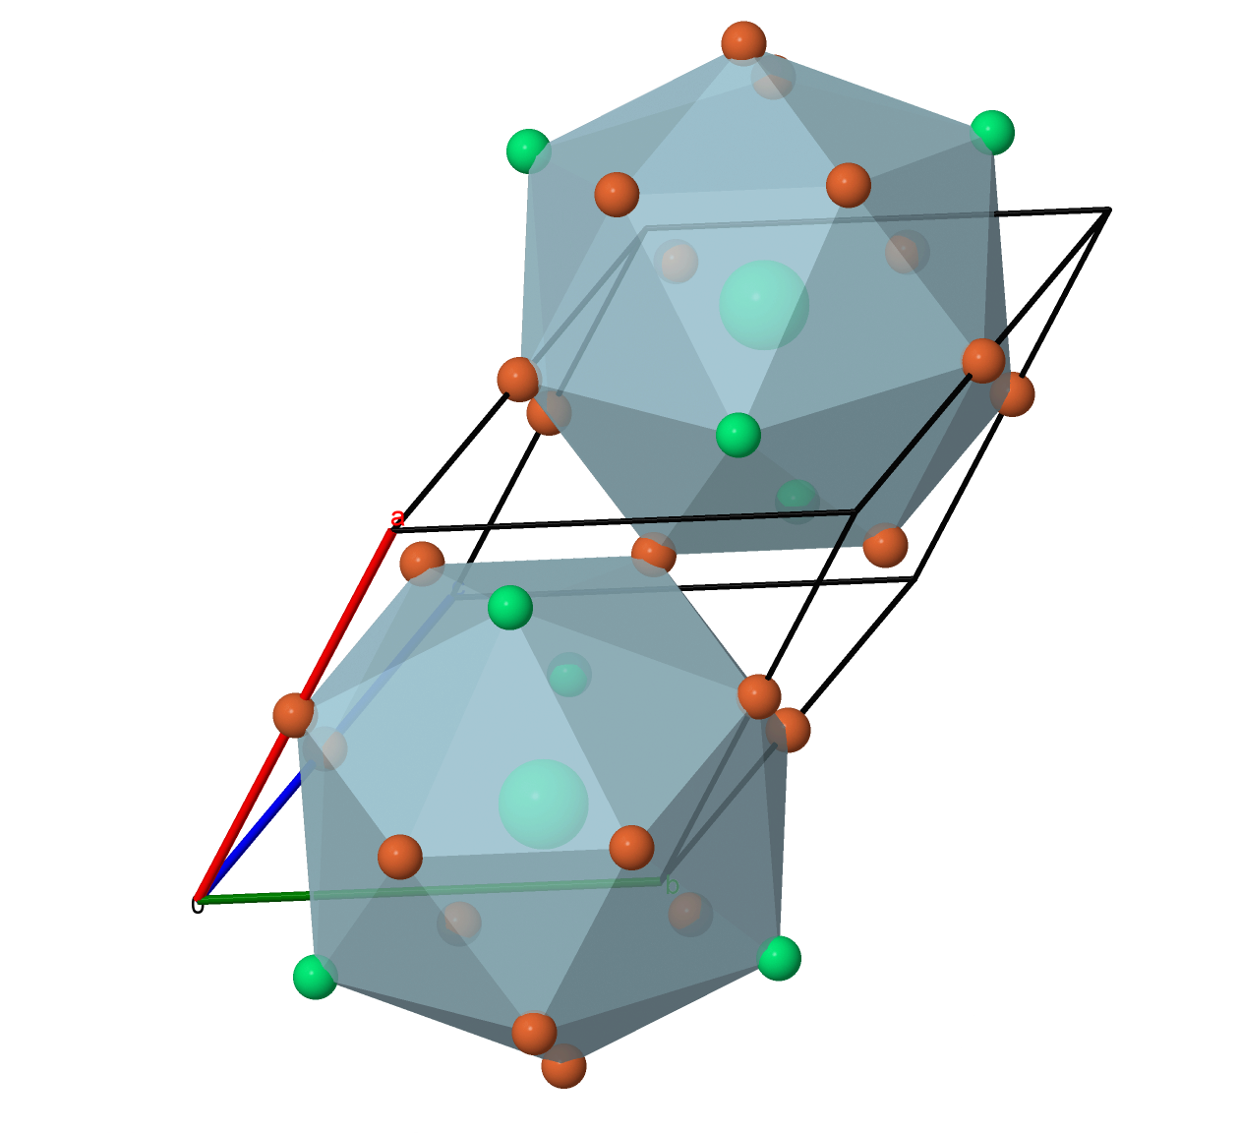
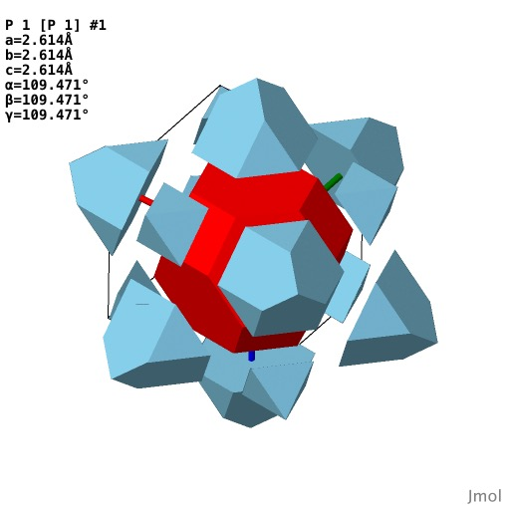
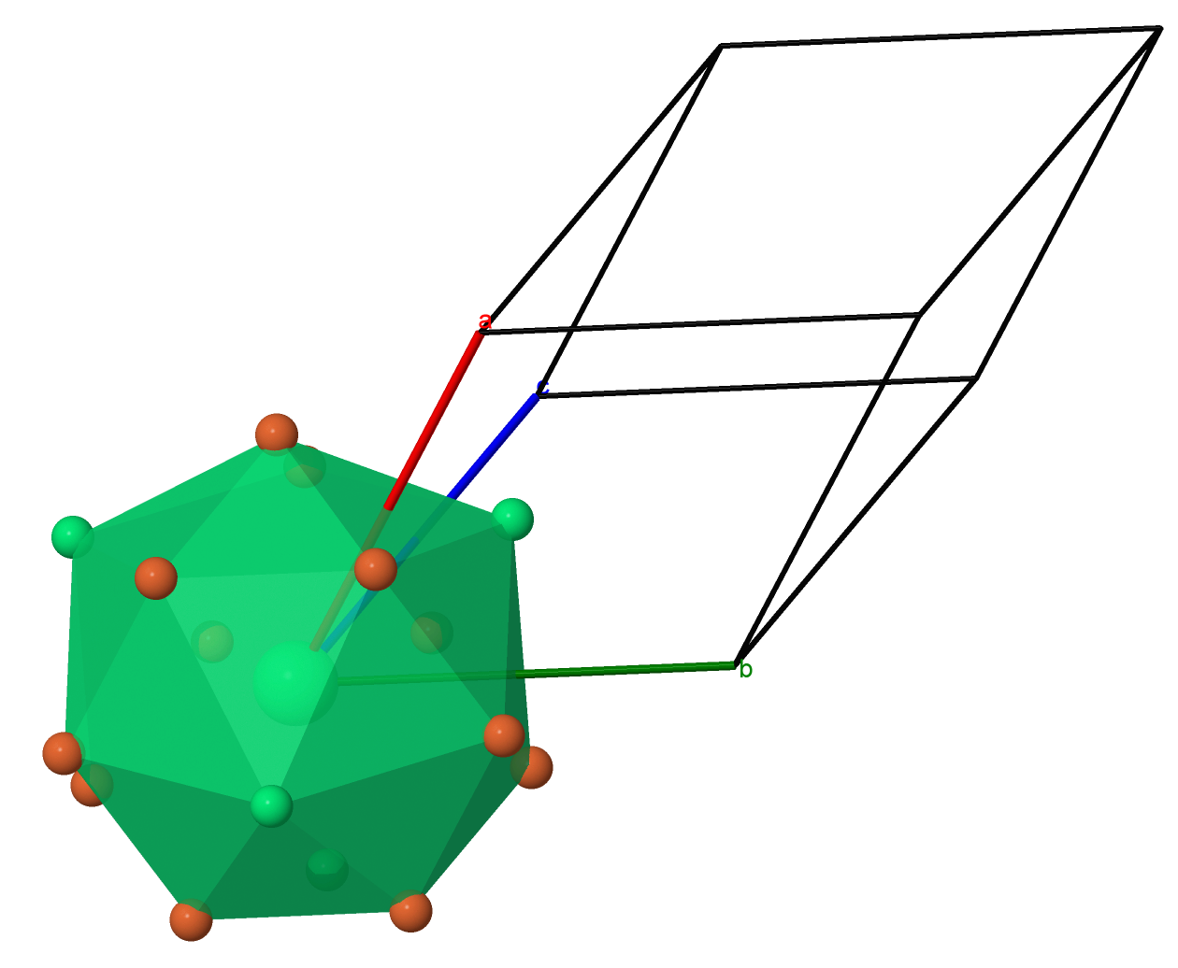

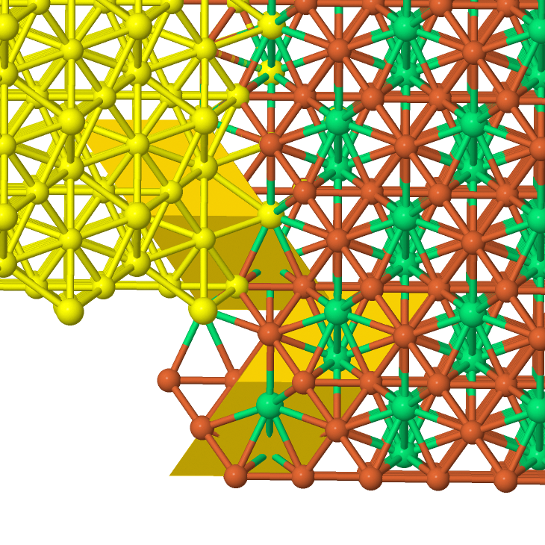
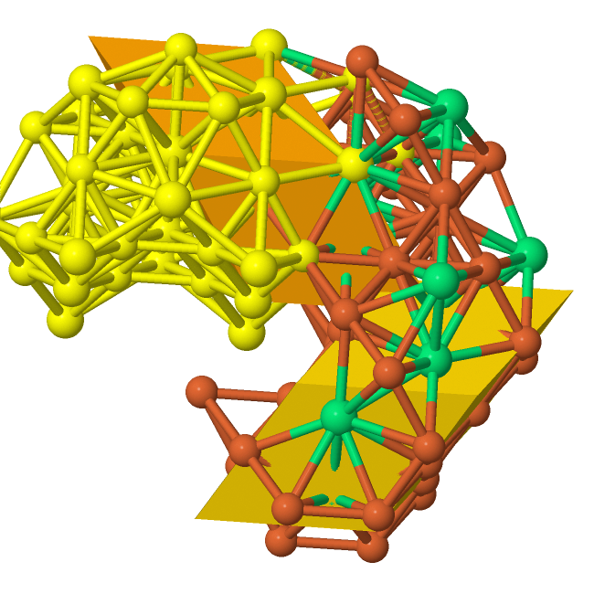
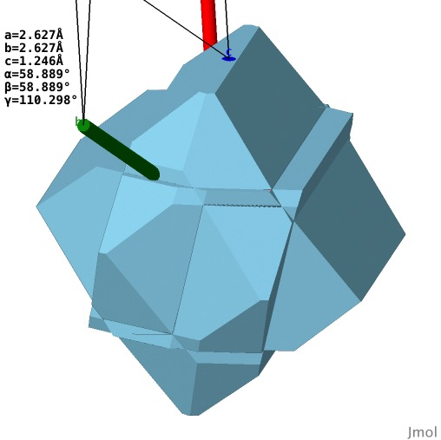
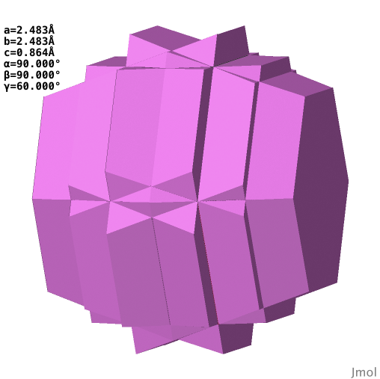
Enhancing AFLOW visualization using Jmol
Jacob LaNasa¹, Brigette Honaker¹, Elizabeth New¹, Patrik Štefek¹, Robert M. Hanson¹, Stefano Curtarolo²
1) St. Olaf College, 2) Duke Materials Science
Abstract
Results
Results
Discussion
The AFLOW library is a database of real and theoretical material properties built on density functional theory. The database is designed to assist experimental material scientists in the discovery and construction of new materials. Jmol, a Java-based program, and JSmol, its JavaScript counterpart, are capable of visualizing and analyzing complex molecular structures.
Through the course of the year, our project has aimed to use Jmol to improve the visualization of the AFLOW database and enhance access to data. We evaluated the capabilities of both Jmol and AFLOW, and then used this knowledge to optimize their interaction. Through Java-based functions, we modified Jmol into an effective tool for interacting with the AFLOW API. With Jmol’s improved functionality, we created a website to access and visualize AFLOW data on binary alloys.
As our collaboration with Duke University continues, we plan to further develop our improvements to the AFLOW database and advance the efficiency of data output for AFLOW users.
Function | Result
aflowLoad(“AaBb”) | Loads all structures at every composition of the given binary compound.
aflowBinaries | Returns a current list of all the available binary compounds from the AFLOW API.
aflowDualArray(“AaBb”, “x”, “y”) | Returns a two column array of any two properties of each structure. (e.g. concentration of Bb and enthalpy of formation)
aflowConvexHull(“AaBb”) | Takes the minimum enthalpy at each concentration and calculates the subset of these points that make up the convex hull.
SMILES (Simplified Molecular Input Line Entry Specification) is a string representation of molecular structure. Used primarily in the field of chemical informatics, SMILES notation allows chemists to find and match compounds in pharmaceutical databases. For example, C/C=C/C is the four-carbon alkene trans-2-butene; c1ccccc1 is the aromatic compound benzene. We have adapted SMILES to be able to represent the atomic environment in the crystal structures of metal alloys. In this adaptation, the atoms given in the SMILES string are those forming a polyhedral atomic environment, and the “bonds” represent edges of that polyhedron.
Our idea was to use our adapted SMILES to map the atomic environment of one crystal structure to that of another, looking for matches, thus providing a novel way to identify equivalent crystal structures that have completely different unit cells and lattices.
Expanded Jmol capabilities via macro script of functions for direct interaction with theoretical binary alloy data files within the AFLOW API.
Implemented script into webpage to provide rapid data output and related visual representation.
Enabled access to and parsing of POSCAR files in a few seconds (prior retrieval took a few minutes and resulting data contained a continuous string for hundreds of models of data).
Provided visualization to convey relevant information for experimentalists (convex hull, animation features, material symmetry, energy minimization, and atomic environment).
Obtained capability of generating higher level Brillouin zones for any model of any compound within binary database along with associated properties.
Verified accuracy of n^{th} Brillouin zone through volume calculation (n^{th} volume agrees with initial volume to within 0.0001%).
Illustrated translation of 2nd Brillouin zone subzones into 1st Brillouin zone using packBZ macro function.
Adapted SMILES notation to identify equivalent crystal structures.
Table 1 : Selection of the AFLOW-specific functions added to Jmol
Fig 6: Primitive unit cells for two independent crystallographic determinations of the structure ErFe₂
Fig 2: Lattice unit cell and reciprocal lattice vectors
Fig 1: Convex hull of the binary AgAl
Methods
Integration of Jmol to interact with the AFLOW API
Construction of proof of concept website that improves user interface, visualization, and speed of data retrieval
N^{th} Brillouin zone generation
Jmol based algorithm starts with primitive unit cell from POSCAR data files
Generates reciprocal lattice structure
Identifies critical plane points
Determines new subzones from planes of previous zone
Slabs subzone planes to create faces
Converts pmesh faces to polyhedra
Finalizes zone
Fig 3 (right):
1st and 2nd Brillouin zones of the face centered cubic lattice
Conclusions
We have succeeded in expanding Jmol’s functionality to work specifically with AFLOW data. Jmol now has the functionality to efficiently interpret and illustrate valuable material properties of theoretical binary compounds. As our project moves forward, we plan to expand the capabilities and applications of current algorithms to coincide with the expressed needs of our collaborators in the AFLOW Consortium. Our objective is to create the world’s best web-based visualization tool for the visualizations of molecular structure in this field.
Fig 7: Er₄Fe₁₂ polyhedral atom environments
Acknowledgements
References
Fig 8: After rotation of Structure 1 (yellow) to align with Structure 2 based on SMILES atom matching followed by quaternion rotation and lattice scaling. Note that the structures need not be matched in size. Lattice scaling is based on volume ratios.
Initial RMSD=5.534×10⁻³ Å, Final RMSD 6.529×10⁻⁷ Å
Special thanks to Corey Oses, Camilo Calderon, and the Curtarolo group of Duke University for their continued collaboration, and to the Office of Naval Research for funding our project.
Jmol: an open-source Java viewer for chemical structures in 3D. http://www.jmol.org/
JSmol: an open-source HTML5 viewer for chemical structures in 3D. http://sourceforge.net/projects/jsmol/
Fig 4: 2nd Brillouin zone of monoclinic lattice
Fig 5: 3rd Brillouin zone of hexagonal lattice

